Slide 1
Sorting
Algorithms
Benchmark
{
< Course : Algorithm, Programming Language : Java , Students : Fatima Naser , Isra’ Hasan >
}
...

Slide 2
Project Goal
01
02
03
Implement Sorting Algorithms
Without built-in Libraries
Compare Execution Time
Analyze Performance
With different input size

Slide 3
Implemented Algorithms
{
..
}
..

Slide 4
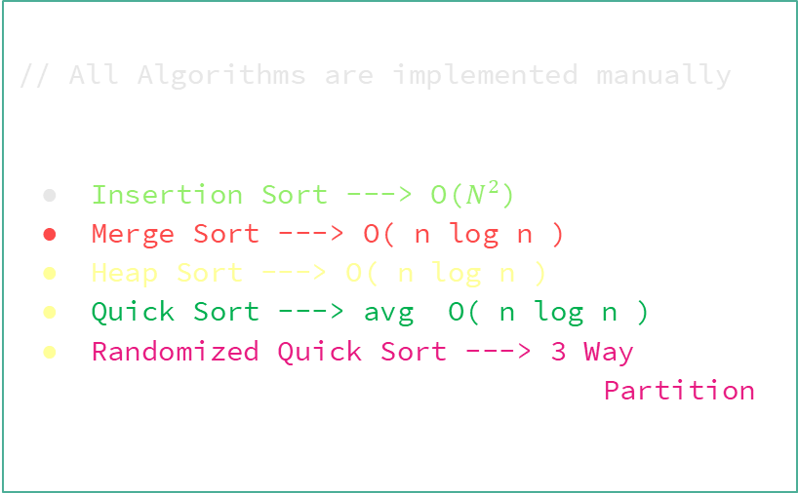
Implement Algorithms
*
// All Algorithms are implemented manually
Insertion Sort ---> O($N^{2}$)
Merge Sort ---> O( n log n )
Heap Sort ---> O( n log n )
Quick Sort ---> avg O( n log n )
Randomized Quick Sort ---> 3 Way Partition

Slide 5
Randomized Quick Sort
{
..
}
..

Slide 6
Randomized Quick Sort
{
Random pivot selection
...
Choosing the pivot randomly instead of having it be fixed prevents the algorithm from being affected by the order of the data.
Avoids worst-case
Improves average performance
In a normal Quick Sort, if the data is sorted, we can reach a complexity of O(n²), but by using a random pivot we reduce this probability.
Overall performance remains close to O(n log n) even with different data types.
}
"That's why we chose Randomized Quick Sort in our implementation."

Slide 7
3 - Way Partitioning
{
..
}
..

Slide 8
3 – Ways Partitioning
{
// The Array was divided into three parts
...
Less Than Povit
Equal To Povit
Greater Than Povit
}
// This Way is effective with duplicate values.

Slide 9
Dataset Types
{
..
}
..

Slide 10
Dataset Types
Random Data
Sorted Data
Reverse Sorted Data
Reverse Sorted Data

Slide 11
Dataset Size
{
..
}
..

Slide 12
Dataset Size
1000 Elements
10,000 Elements
50,000
Elements
100,000
Elements
Used to analyze scalability

Slide 13
Data Generation
{
..
}
..

Slide 14
{
One dataset generated per test
...
A single array of random values ​​is generated for each experiment. This array represents the underlying dataset on which the algorithms will be tested.
Array copied for each algorithm
Ensures fair comparison
Before any sorting algorithm is run, an exact copy of the original array is created. Each algorithm works on the same data but on an independent copy.
This method prevents the effect of data sorting or modification by a previous algorithm, thus ensuring a fair comparison in terms of time and performance between all algorithms.
}

Slide 15
Performance Measurement
{
..
}
..

Slide 16
Performance Measurement
{
..
Using
System.currentTimeMillis()
Execution time calculation
Execution time in milliseconds (ms)
The System.currentTimeMillis() function in Java was used to get the current time on the system.
Execution time = Time after sorting − Time before sorting
The results are expressed in milliseconds.
Measure time before and after sorting
The time is recorded immediately before the sorting process begins, and then the time is recorded again after it is completed.
*
}
..

Slide 17
Result Table
{
..
}
..

Slide 18
Sortind Algorithm Random Data
{
Dataset Size | Insertion Sort (ms) | Merge Sort (ms) | Heap Sort (ms) | Quick Sort (ms)
1,000 | 2 ms | 1 ms | 10 ms | 1 ms
10,000 | 43 ms | 2 ms | 2 ms | 1 ms
50,000 | 174 ms | 9 ms | 8 ms | 7 ms
100,000 | 679 ms | 38 ms | 14 ms | 17 ms
}

Slide 19
Sortind Algorithm Sorted Data
{
Dataset Size | Insertion Sort (ms) | Merge Sort (ms) | Heap Sort (ms) | Quick Sort (ms)
1,000 | 0 ms | 0 ms | 1 ms | 0 ms
10,000 | 1 ms | 1 ms | 2 ms | 1 ms
50,000 | 0 ms | 3 ms | 5 ms | 6 ms
100,000 | 1 ms | 5 ms | 9 ms | 9 ms
}

Slide 20
Sortind Algorithm Reverse Sorted Data
{
Dataset Size | Insertion Sort (ms) | Merge Sort (ms) | Heap Sort (ms) | Quick Sort (ms)
1,000 | 18 ms | 0 ms | 0 ms | 0 ms
10,000 | 52 ms | 1 ms | 2 ms | 1 ms
50,000 | 356 ms | 4 ms | 7 ms | 6 ms
100,000 | 1320 ms | 6 ms | 8 ms | 8 ms
}

Slide 21
Sortind Algorithm Few Unique Data
{
Dataset Size | Insertion Sort (ms) | Merge Sort (ms) | Heap Sort (ms) | Quick Sort (ms)
1,000 | 7 ms | 1 ms | 0 ms | 0 ms
10,000 | 5 ms | 1 ms | 2 ms | 0 ms
50,000 | 129 ms | 13 ms | 5 ms | 1 ms
100,000 | 530 ms | 9 ms | 8 ms | 1 ms
}

Slide 22
Result Line Chart
{
..
}
..

Slide 23
Line Chart – Random Data
{
}

Slide 24
Line Chart – Sorted Data
{
}

Slide 25
Line Chart – Reverse Sorted Data
{
}

Slide 26
Line Chart – Few Unique Data
{
}

Slide 27
Results Summary
{
..
}
..

Slide 28
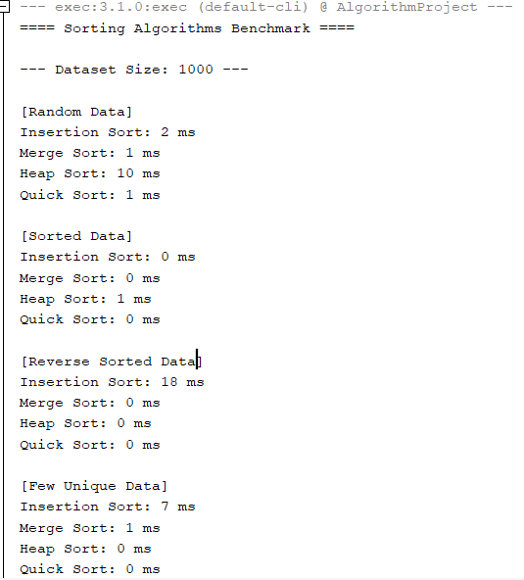
Insertion sort
{
Excellent with sorted data and small datasets
Very slow with reverse sorted data and large datasets
Performance deteriorates significantly as data size increases
}
...

Slide 29
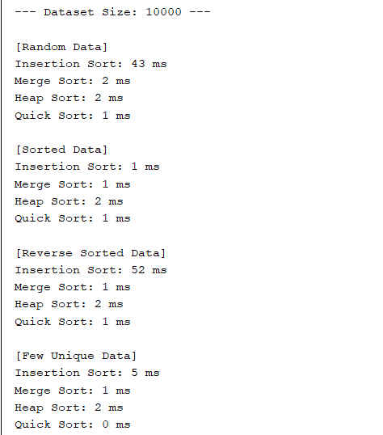
Merge sort
{
Consistent performance with all data types
Unaffected by data sorting
Suitable for large datasets and performance-sensitive systems
}
...

Slide 30
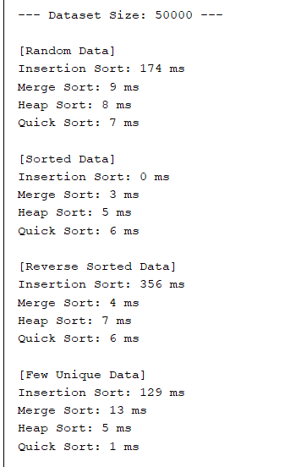
Heap sort
{
Stable performance, similar to Merge Sort
Less affected by data type
Slightly slower than Quick Sort in some cases
}
...

Slide 31
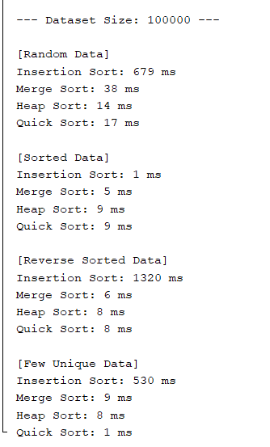
Quick sort
{
Overall fastest in most scenarios
Excellent performance with random data and few unique datasets
Avoids worst-case scenarios thanks to random pivot selection
}
...

Slide 32
System.out.println("\n----- Thank You
----- ")!
{
}
...

